Slide 1
Trends in bioengineering
Bio printing technique and it’s application

Slide 2
Bio printing
Bioprinting (also known as 3D bioprinting)
is combination of 3D printing with biomaterials to replicate parts that imitate
natural tissues,
bones
blood vessels in the body

Slide 3
Bio printing Applications
production of human organ and tissue structures for research
Create organs that can be fully integrated into the human body
Organ implantation
Prevent cell rejection

Slide 4
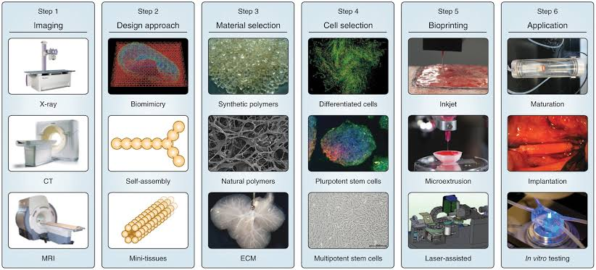
Bio printing materials
alginate, chitosan, gelatin, collagen, fibrin

Slide 5
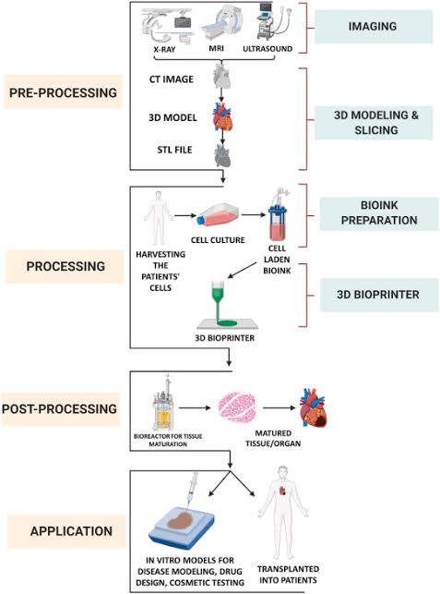
Process in bio-printing

Slide 6
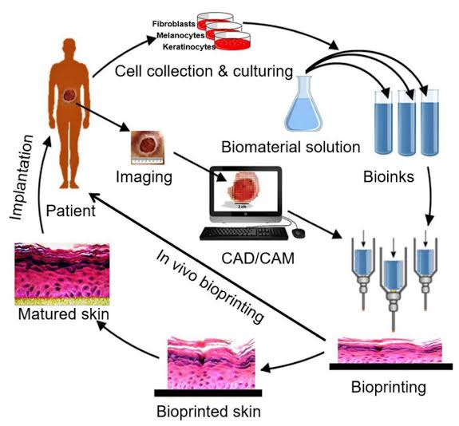
Bio printing technology

Slide 7


Slide 8
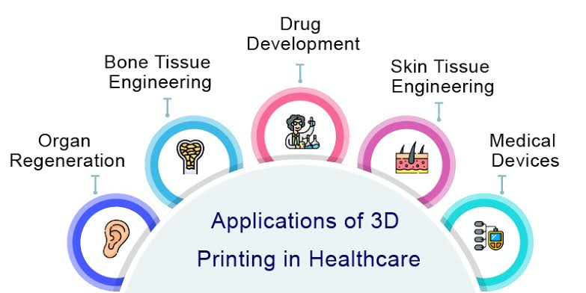
Applications

Slide 9
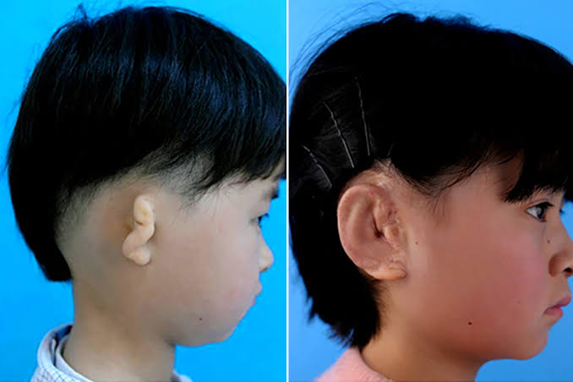
3d printed ears
Pga(polyglycolic acid)
Plla(poly-l-lactic acid)
Pet(polyethylene terephthalate)
Cell embedded materials:
Gelatine methacryloyl
alginate

Slide 10
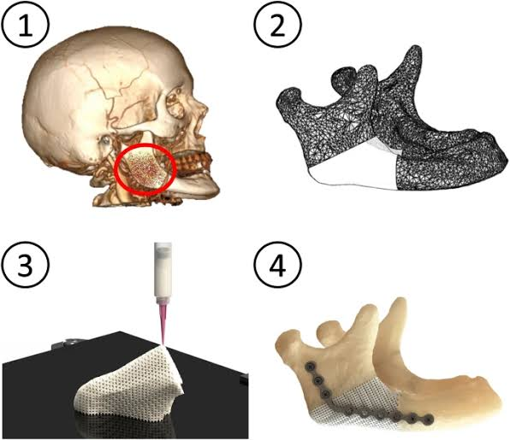
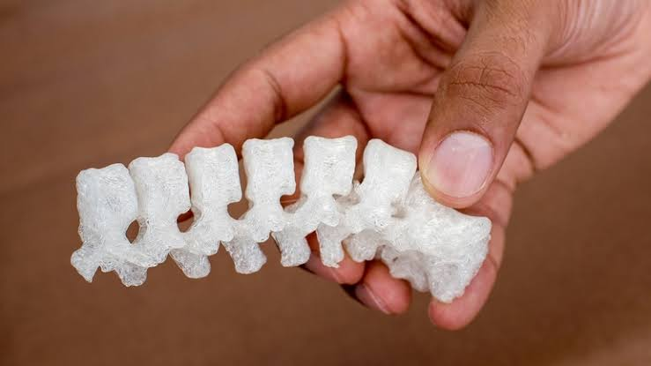
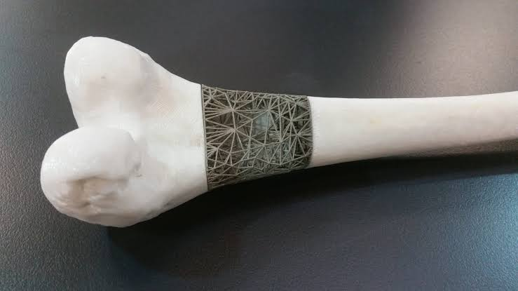
3d printed bone
Materials used:
Alginate
Chitosan
Gelatinc
Collagen
fibrin

Slide 11
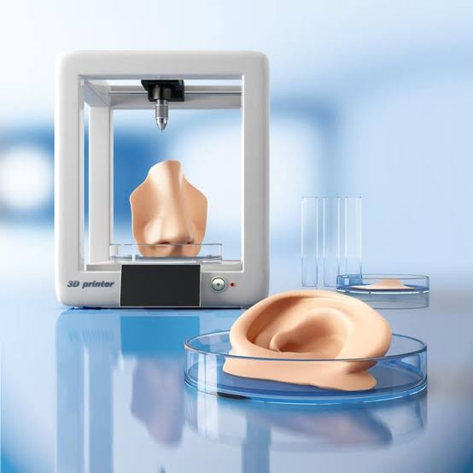
3d printed skin
Cosmetic testing
Wound healing
Drug development
Bioink made from living cells

Slide 12
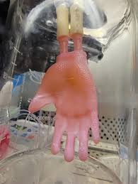
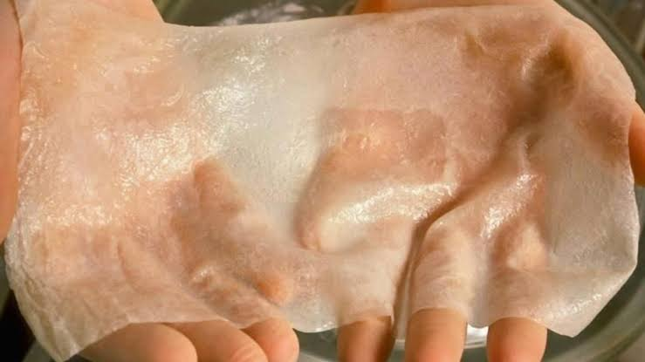
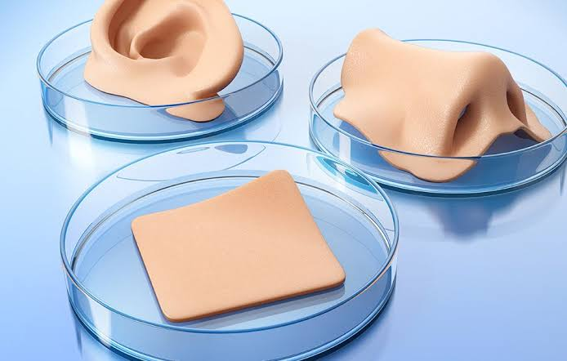
Preparation of bioink
Mixture of
Human skin cells
Fibroblasts
Keratinocytes
2. hydrogelel matrix
Along with supportive environment for cell growth

Slide 13
Thank you

